Slide 1
BASIC COMPUTER ORGANISATION
Rare Project
Abhinav 11A

Slide 2
Contents
Introduction
Basic Components
Overview about computer systems
Hardware and Software
I/O Devices
CPU
Memory

Slide 3
Overview
A computer system consists of various components that work together to perform tasks. In this essay, we will explore the basics of computer organization, including hardware, software, input/output devices, CPU, memory, and units of memory.

Slide 4
Before we begin…
What are the basic components of a computer system?
What is software, and how does it differ from hardware?
How does RAM affect a computer's performance?

Slide 5
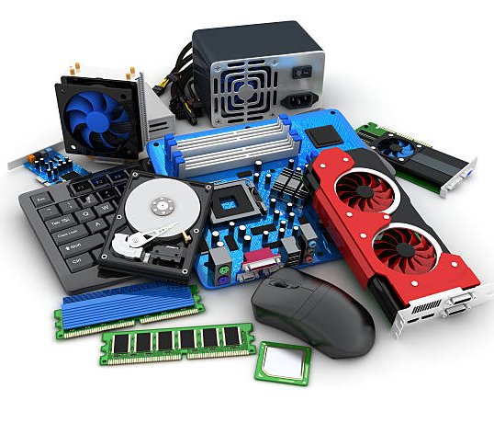
UNDERSTANDING HARDWARE
Hardware refers to the physical components of a computer system.
Examples include CPU, memory, input/output devices, and storage devices.

Slide 6
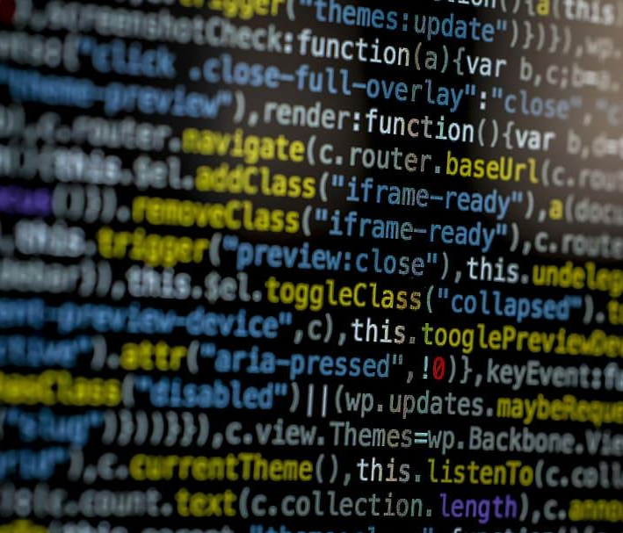
SOFTWARE
It is a set of instructions that tells a computer what to do. It is a non-tangible component of a computer system that is responsible for performing various tasks.
Software is a generic term used to refer to applications, scripts and programs that run on a device.

Slide 7
INPUT DEVICES
Input devices are devices that send control signals to a computer.
They convert input data into digital form that is acceptable by the computer system.
Examples of input devices include keyboard, mouse, scanner, touch screen, and braille keyboards.
Voice recognition technology allows users to input data through their voice.
Data entered through input devices is temporarily stored in main memory or RAM.
For permanent storage and future use, data and instructions are stored in secondary memory.

Slide 8
OUTPUT DEVICES
An output device is a device that receives data from a computer system for display or physical production.
It converts digital information into human-understandable form.
Examples of output devices include monitor, projector, headphone, speaker, printer, and 3D printer.
A braille display monitor is useful for visually challenged individuals to understand textual output.
A printer is the most commonly used device to get output in physical (hardcopy) form.
Three commonly used printers are inkjet, laserjet, and dot matrix.
3D printers are used to build physical replicas of digital 3D designs, and are used in manufacturing industries to create prototypes of products.
The usage of 3D printers is also being explored in the medical field for developing body organs.

Slide 9
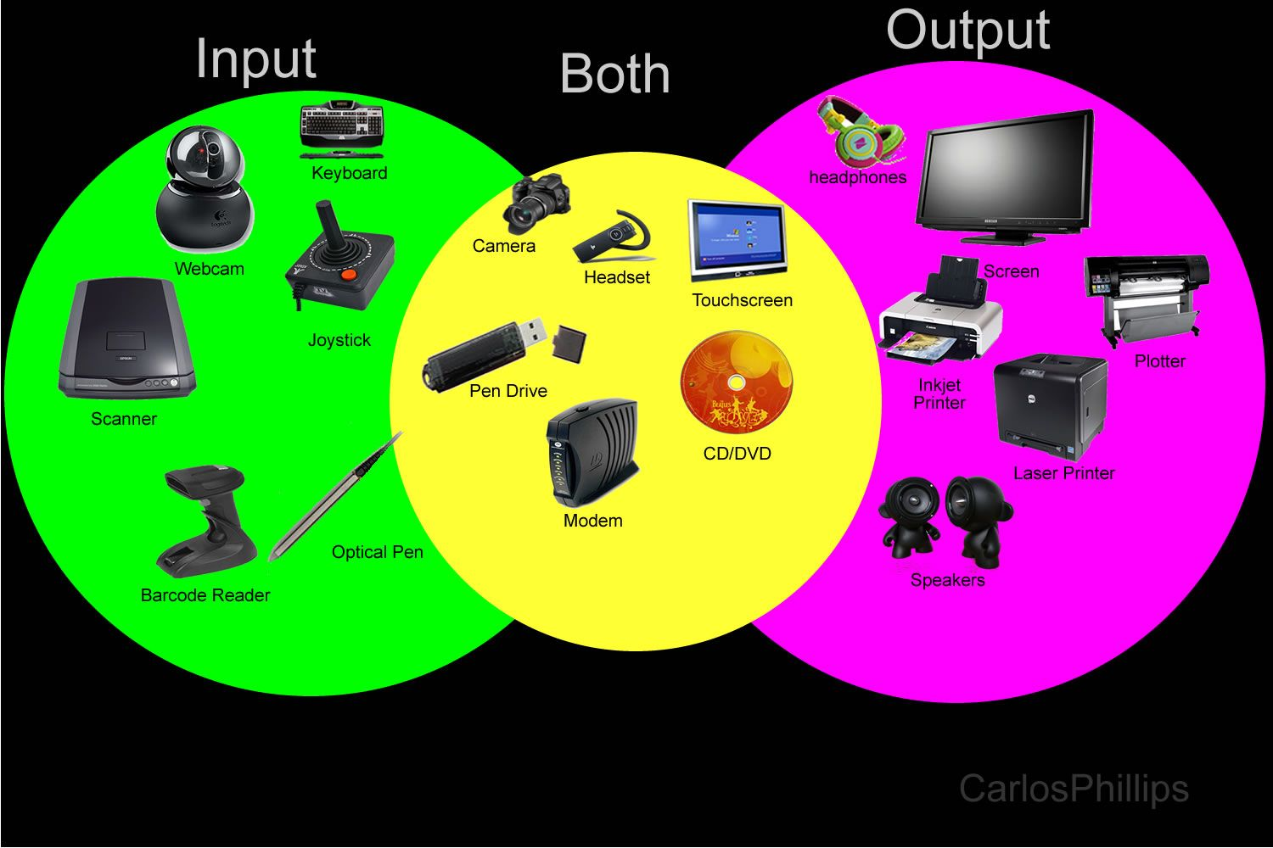

Slide 10
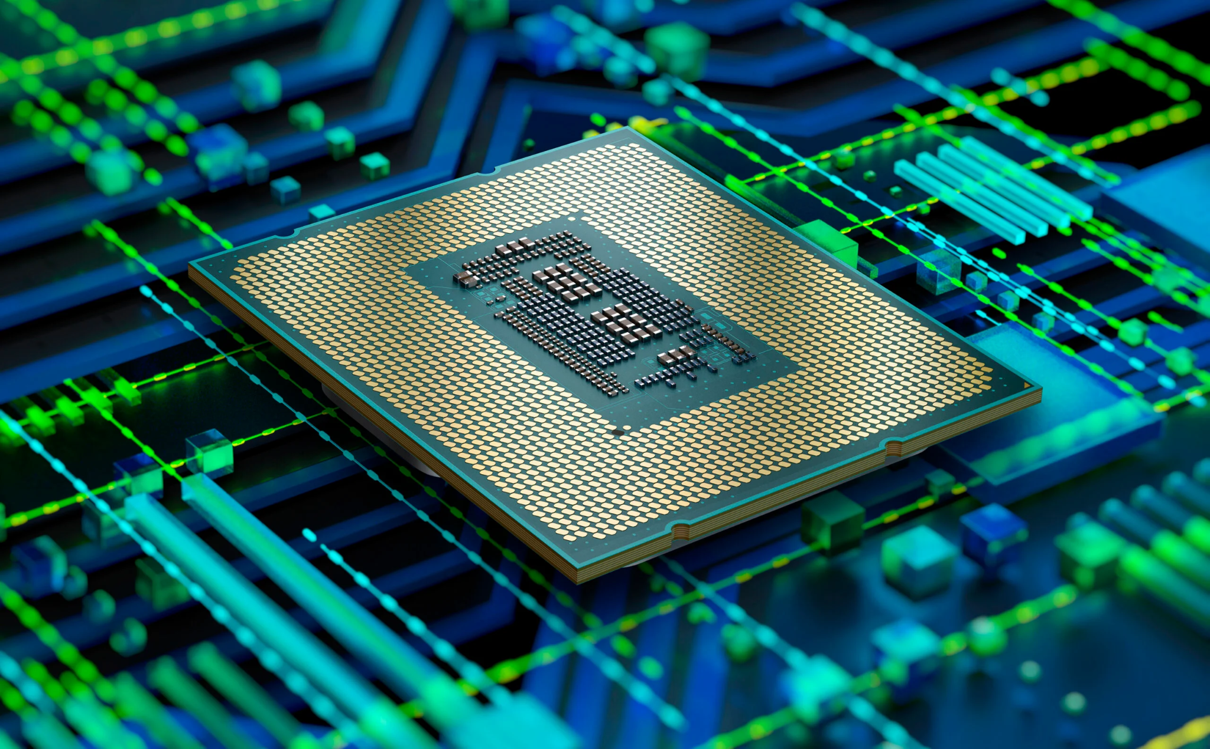
WHAT IS THE MOST IMPORTANT PART OF A COMPUTER?
THE CPU
The CPU, also known as the processor, is the electronic circuitry in a computer that carries out processing. It can be placed on one or more microchips, also called integrated circuits (ICs), that comprise semiconductor materials. The CPU receives instructions and data through programs and fetches them from memory to perform arithmetic and logic operations, storing the results back in memory. It has local memory called registers for temporary storage, as well as two main components - the Arithmetic Logic Unit (ALU) for arithmetic and logic operations, and the Control Unit (CU) for instruction execution and data flow control. The CPU is also referred to as a microprocessor.

Slide 11

COMPUTER MEMORY
A computer system requires memory to store data and instructions for processing. The primary memory is used for temporary storage of data, while the secondary memory is used for permanent storage of data, instructions, and results. The primary memory is also referred to as RAM, while the secondary memory is also known as storage devices.

Slide 12
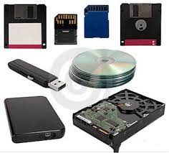
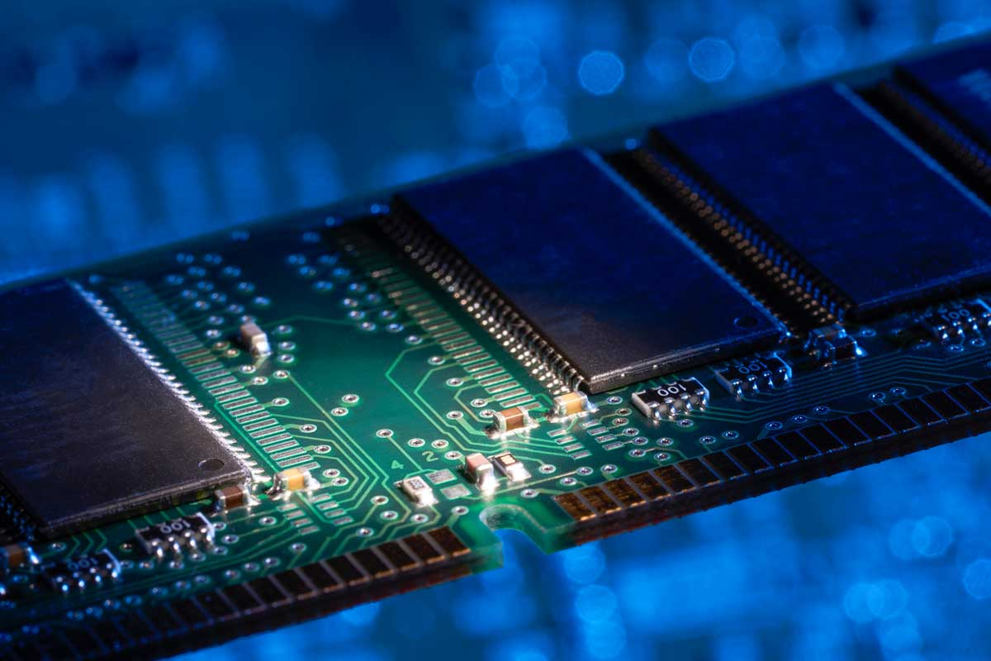
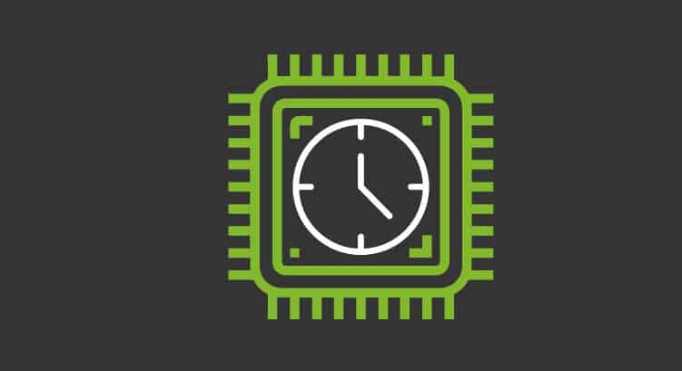
TYPES
Secondary
Secondary memory has larger storage capacity than primary memory, but it is slower and cheaper. It is non-volatile and stores data permanently. Examples include HDD, CD/DVD, memory cards, and flash drives. SSDs offer faster data transfer speeds than traditional HDDs.
Primary
Cache
This memory is crucial for computers, and it is of two types: RAM and ROM. RAM is volatile, while ROM is non-volatile and stores the boot loader program for loading the operating system.
It is used to store frequently accessed data to speed up CPU operations.

Slide 13
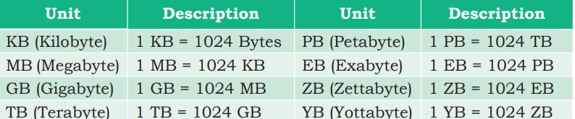
UNITS OF MEMORY
A computer system uses binary numbers consisting of bits, which are the basic units of memory. A group of 4 bits is called a nibble, while a group of 8 bits is called a byte. Bytes are then grouped together to form larger units of memory. Different measurement units for digital data stored in storage devices are shown in the table

Slide 14
RECAP
What is primary memory, and how is it different from secondary memory?
How do the different units of memory relate to each other in terms of size and capacity?
What is an input device, and what are some examples of common input devices?
What is a computer system, and what are its basic components?

Slide 15
SOLUTIONS
Primary memory, also known as main memory, is a type of memory that is directly accessible to the CPU. It is used to store data and instructions that are currently being executed by the CPU. Examples of primary memory include RAM and ROM. Secondary memory, on the other hand, is a type of memory that is not directly accessible to the CPU. It is used for long-term storage of data and programs, and examples include hard drives, solid-state drives (SSDs), and flash drives.
The units of memory used in computing increase in size and capacity by multiples of 1024. The smallest unit is a bit, which represents a single binary digit (either a 0 or a 1). A byte is made up of 8 bits, and is used to represent a single character. The units then increase in size as follows: 1 kilobyte (KB) = 1024 bytes, 1 megabyte (MB) = 1024 KB, 1 gigabyte (GB) = 1024 MB, 1 terabyte (TB) = 1024 GB, 1 petabyte (PB) = 1024 TB.
An input device is a piece of hardware that is used to enter data and commands into a computer system. Examples of common input devices include keyboards, mice, touchscreens, scanners, and microphones.
A computer system is a combination of hardware and software that is used to process and store data. The basic components of a computer system include the CPU, memory, storage devices (such as hard drives and solid-state drives), input devices (such as keyboards and mice), output devices (such as monitors and printers), and various other peripherals and components.

